Slide 1

Getting Customered
Improving Your Social Media Conversion Rate
Brian Massey
Conversion Sciences, LLC
Tweet Something
@bmassey #engagemex
Notes:
"Getting Customered: Improving Your Social Media Conversion Rate"
Description:
It's great to be liked, friended and followed. It's also great to be customered, when someone actually buys from you. Lurking in your social networks are people who have the problem you solve, who need what you offer, who want to get what you've got. Getting these people to "customer" you is how social media becomes sustaining media. Brian Massey will show you how to get customered more often by your social network. You will learn:
* How to keep your social promises.
* How to charge and discharge your social batteries.
* Where to find the huge social network that you're ignoring.
* How to make effective social media landing pages.

Slide 2
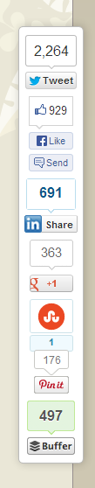
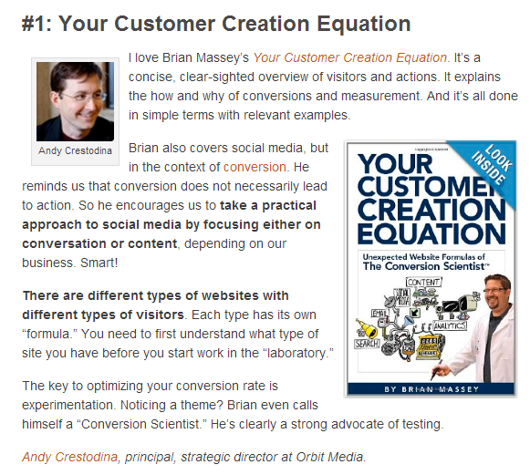
Awesome Placement
200,000 Facebook Fans!
Cha Ching!
250,000 Subscribers!

Slide 3
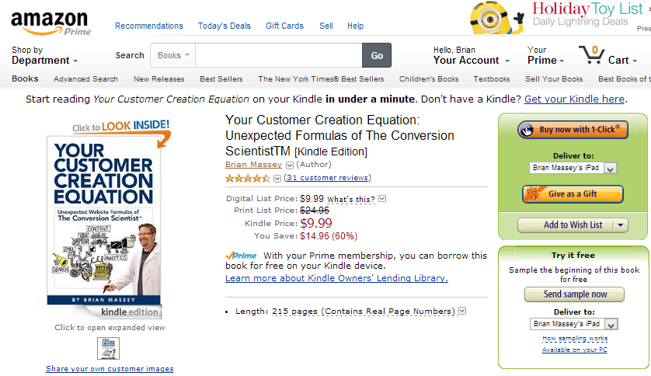
It linked directly to my Amazon.com page!

Slide 4
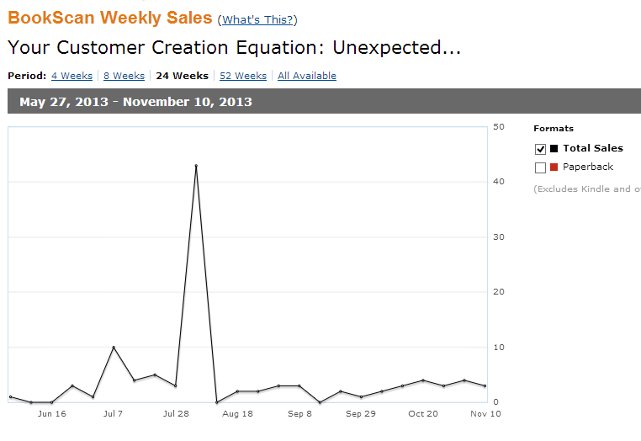

How many books did I sell?
43
LanderApp Email
?
Social Media Examiner Mention
Amazon.com Author Central

Slide 5


They “Liked” me.
They didn’t “Customer” me.

Slide 6
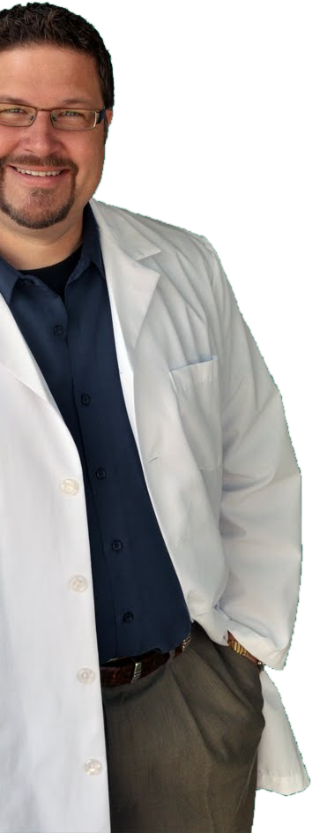
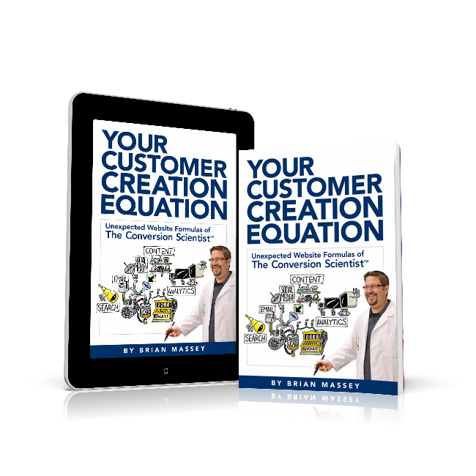
Salesman
Computer Scientist
Corporate Marketer
Enterpreneur
Conversion Scientist
Founder of Conversion Sciences
Consultant
National Speaker
Author Your Customer Creation Equation
Labwear Fashion Model

Slide 7

Don’t Think. Know.
Conversion Catalyst Consulting
PPC Landing Page Optimization
Video that Converts
Analytics
Visitor Personas
Feared by Competitors Across the Internet

Slide 8
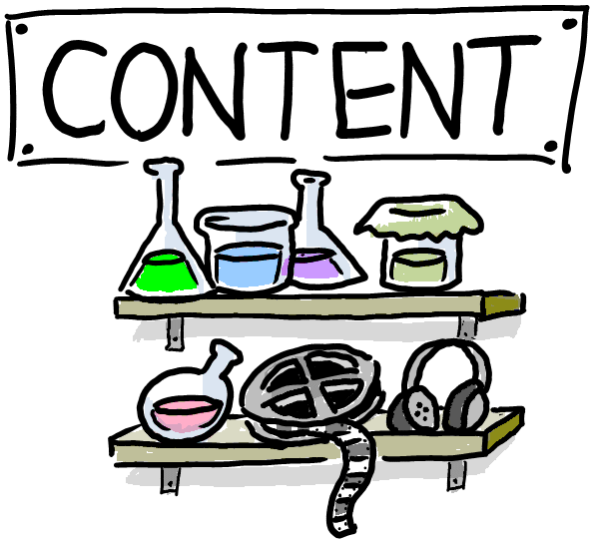


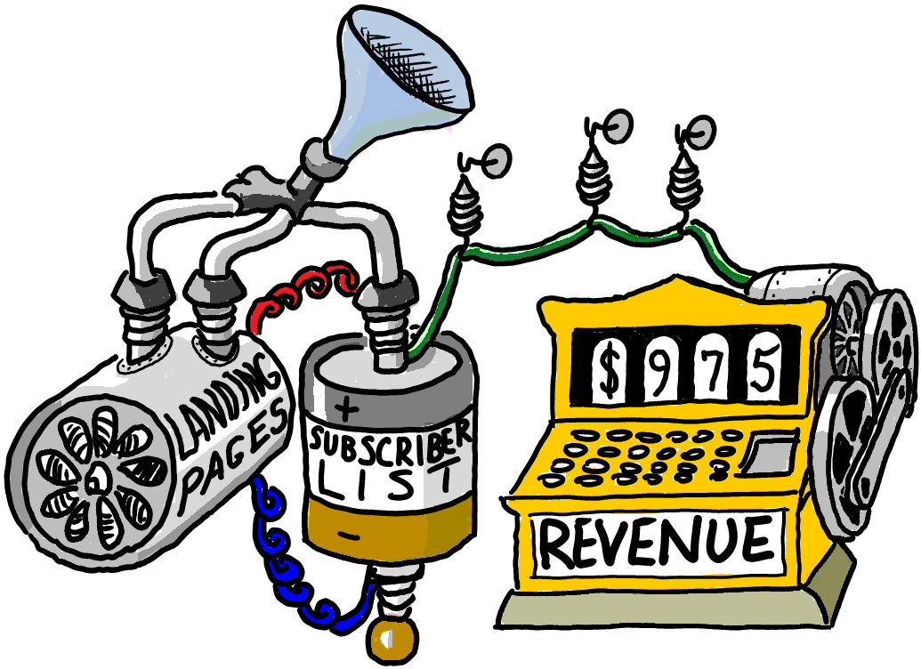
Get Customered

Slide 9
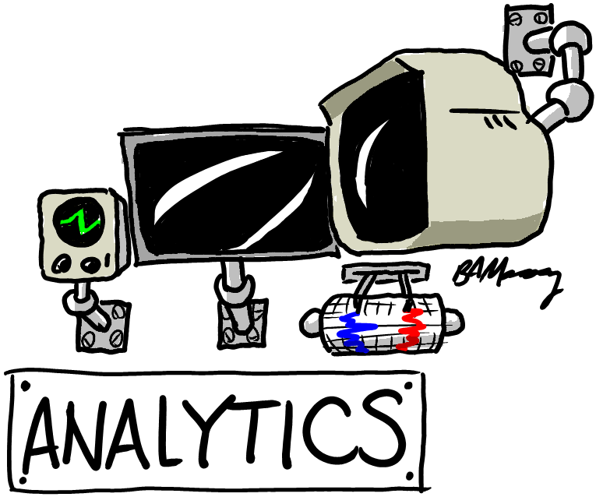
Know How to Get Customered

Slide 10

Charging your social battery
Get Noticed
Get Liked
Get Followed
Get Connected

Slide 11
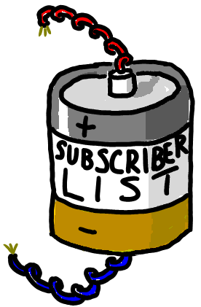
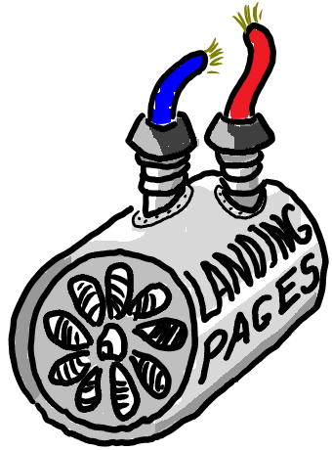
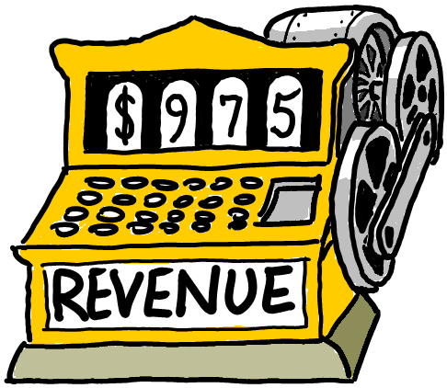
Tapping Your Social Battery

Slide 12
Landing Page
Any page that must keep a promise and get a visitor to take some action in a
measureable way.

Slide 13
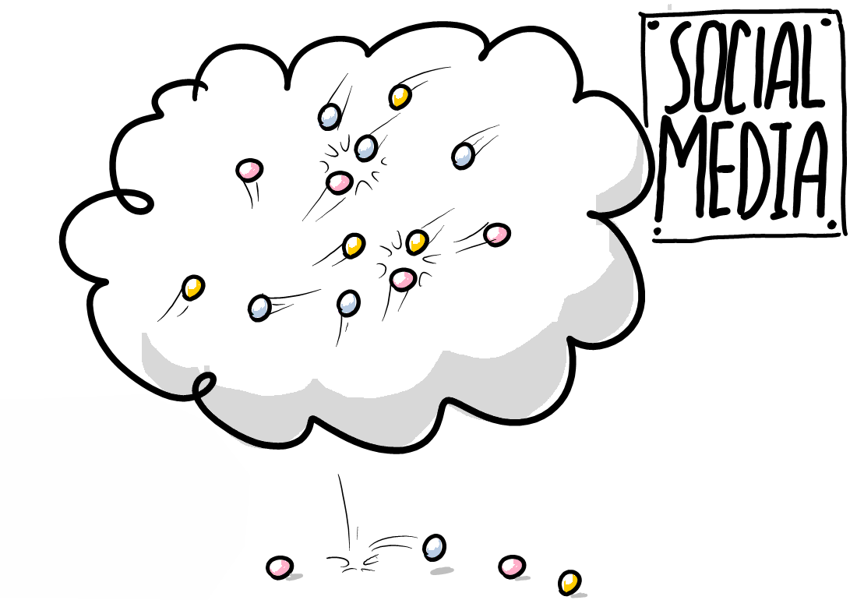



Slide 14
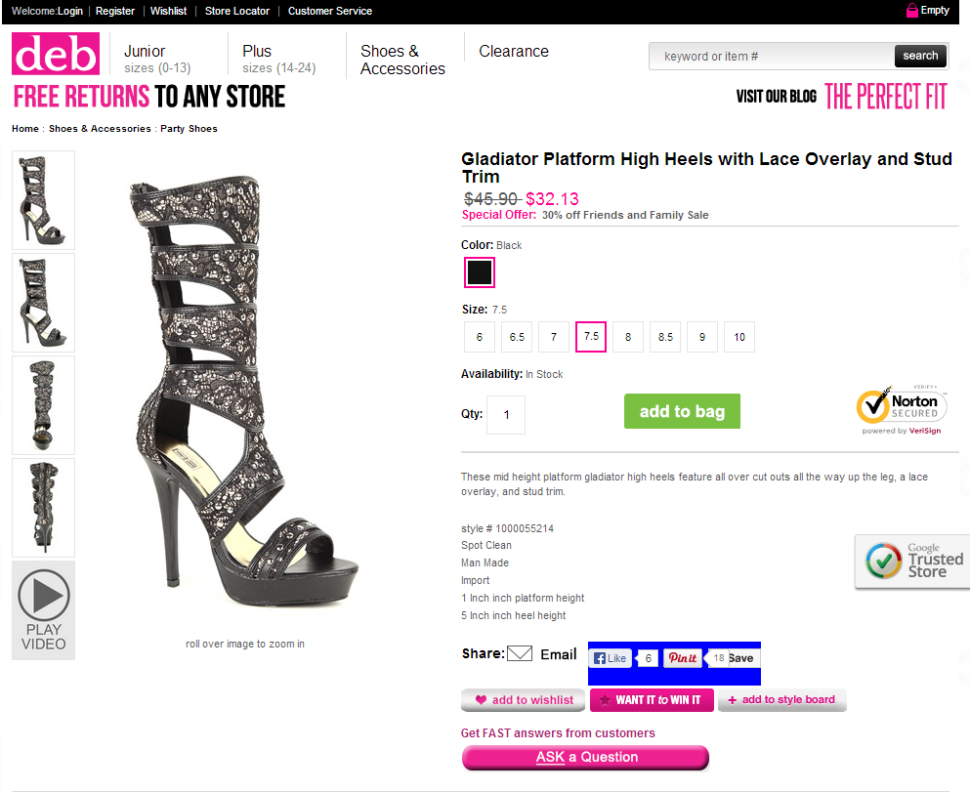
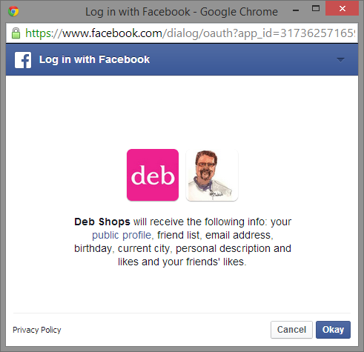

Revenue or Database?

Slide 15
Why Build a Subscriber List?
Email is the biggest social network on the planet.
Billions of users worldwide.
Used by all age groups.
Checked hourly by business people.
Personal, one-to-one.
Owned by you, not Mark Zuckerberg.
It works Better.
Notes:
Email is bigger than Facebook
You own your subscriber database, not Mark Zuckerberg
Email subscribers are better qualified than social subscribers

Slide 16
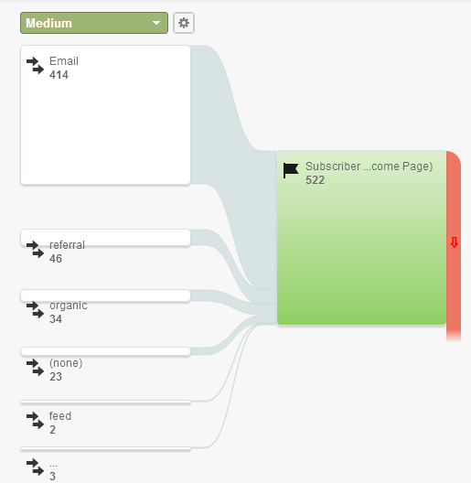
Filtered for Subscribers Only

Slide 17
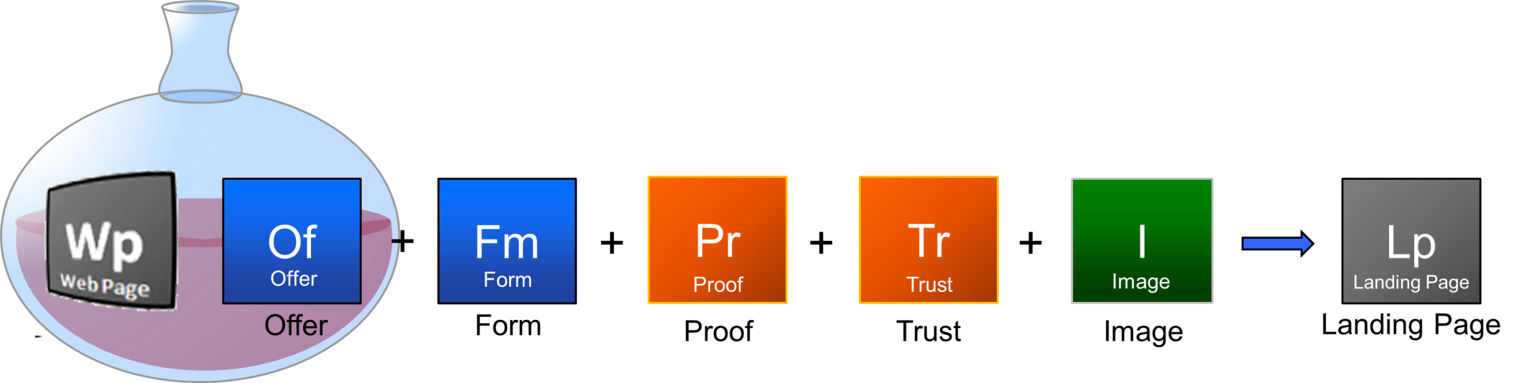
The Recipe for Great Landing Pages

Slide 18
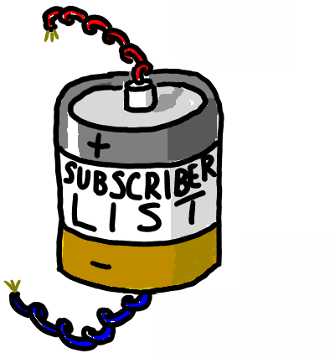
What do they want?
Of
Offer

Slide 19
What do you want them to do?
Fm
Form

Slide 20
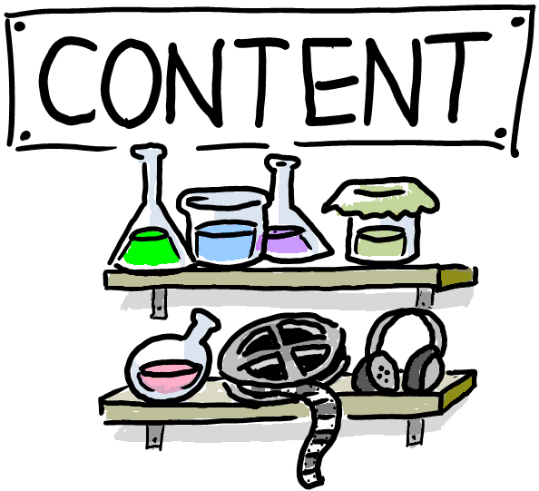
Content Brings Traffic to Your
Landing Pages
Posts with links get shared more.
Links get prospects back to your site.
High frequency
Notes:
Posts with links get shared more.
Links get people back to your site.

Slide 21
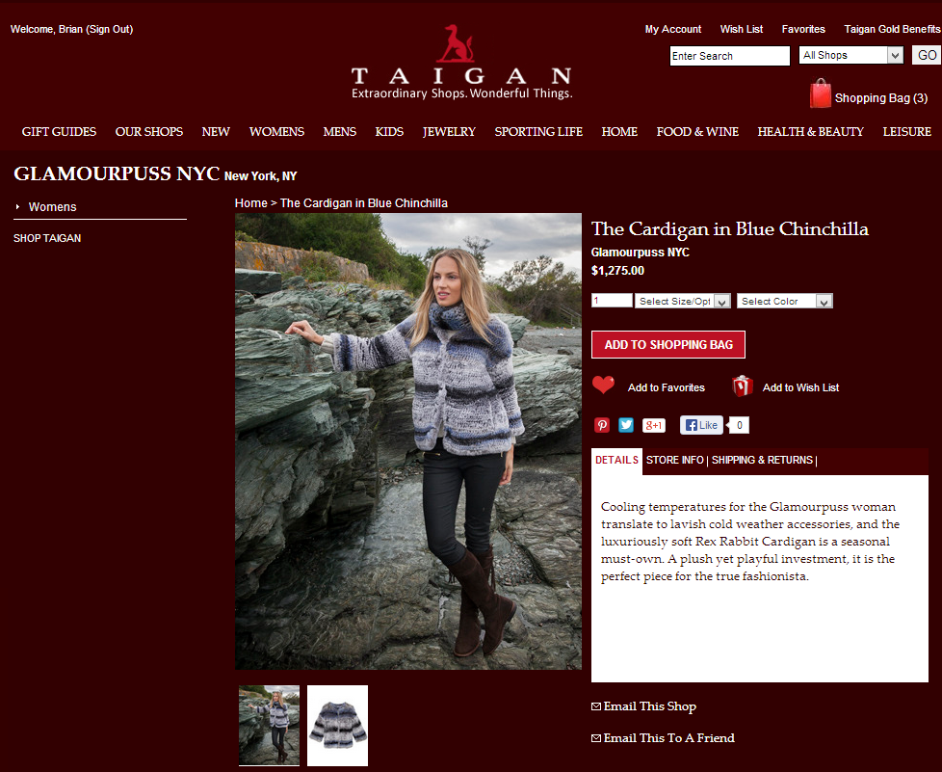
Typical Landing Pages
Ecommerce Product Pages

Slide 22
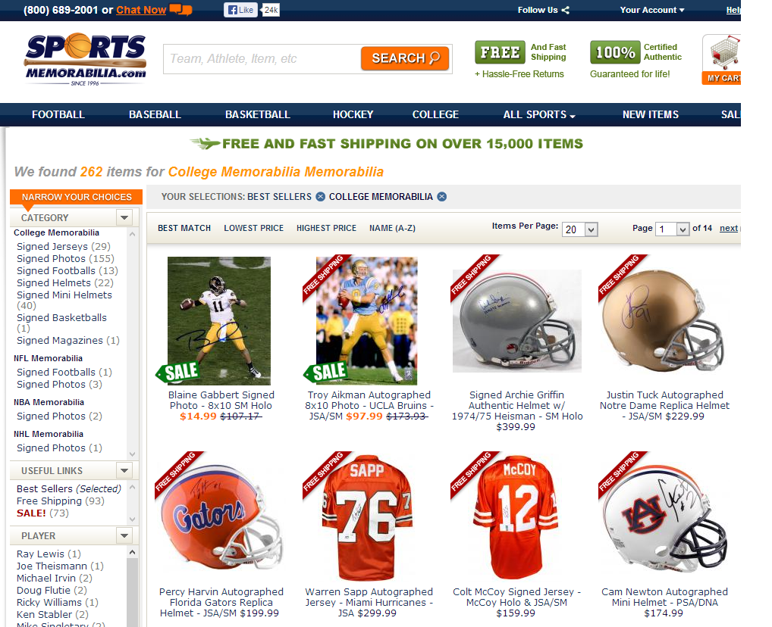
Typical Landing Pages
Ecommerce Category Pages

Slide 23
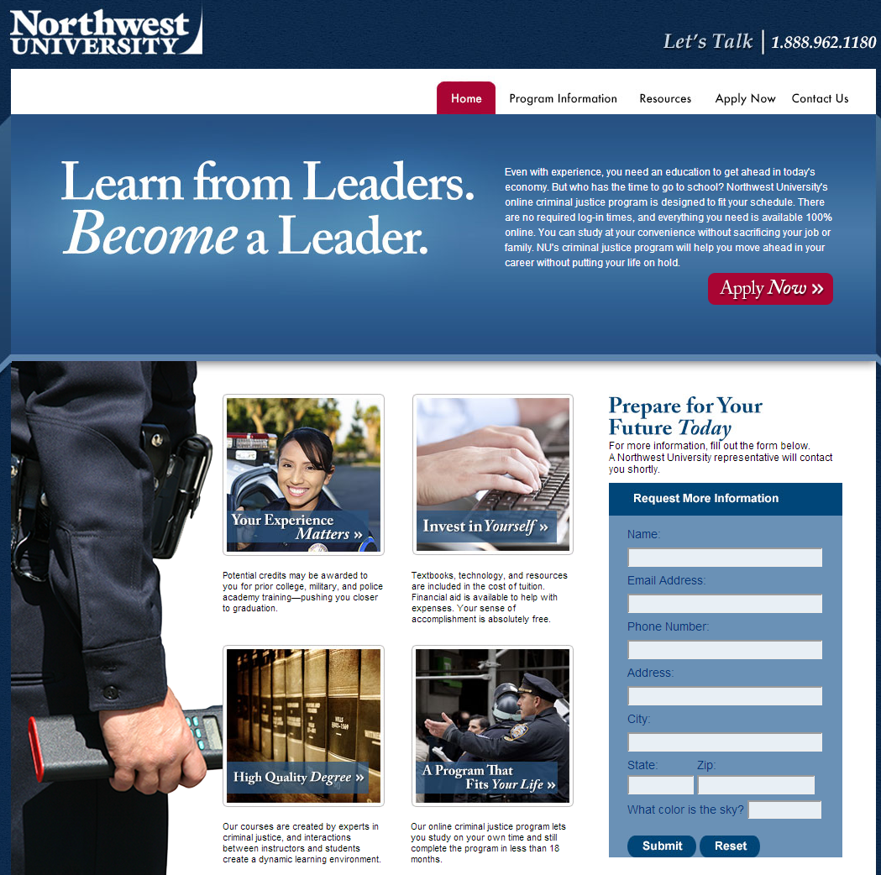
Typical Landing Pages
Custom Landing Pages

Slide 24
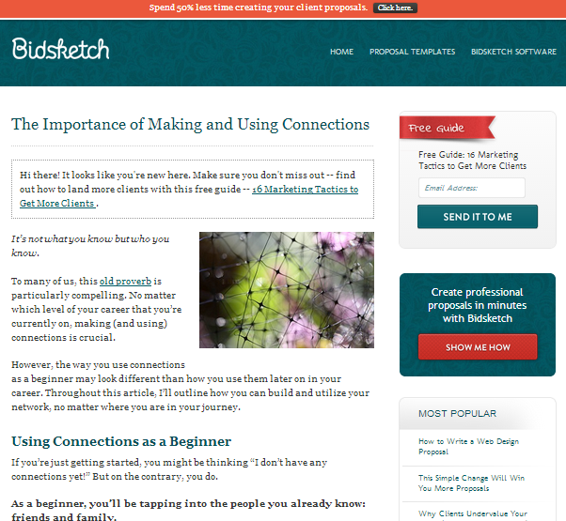
Typical Landing Pages
Blog Content Pages

Slide 25
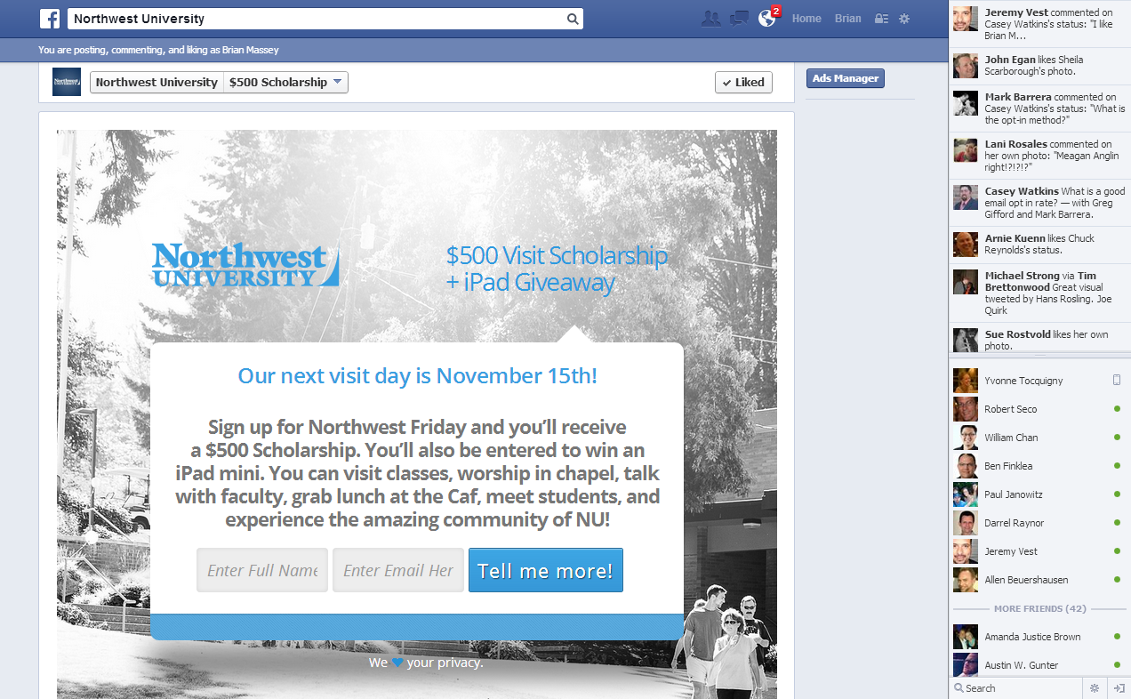
Typical Landing Pages
Social Network Pages

Slide 26
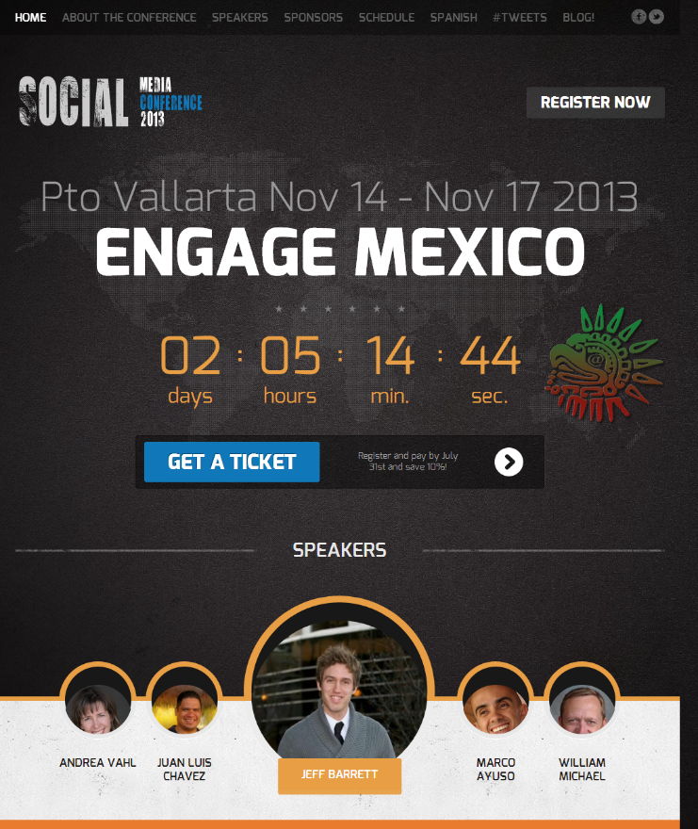
Typical Landing Pages
Home Pages

Slide 27
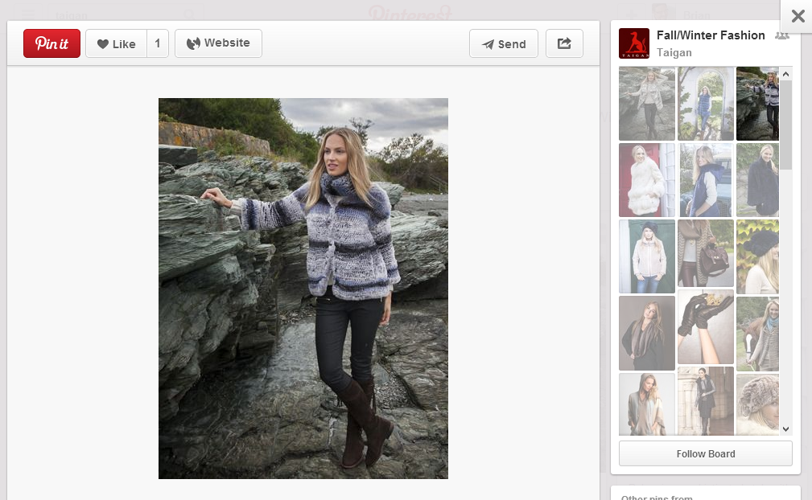
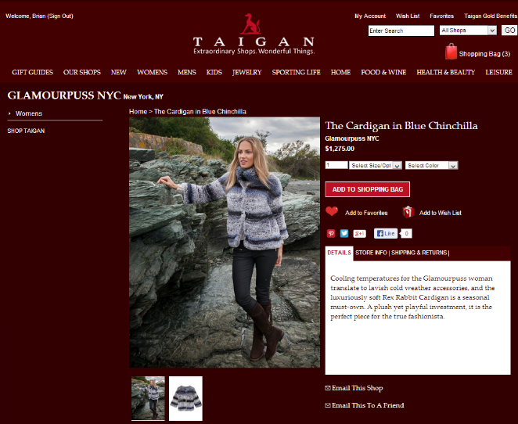
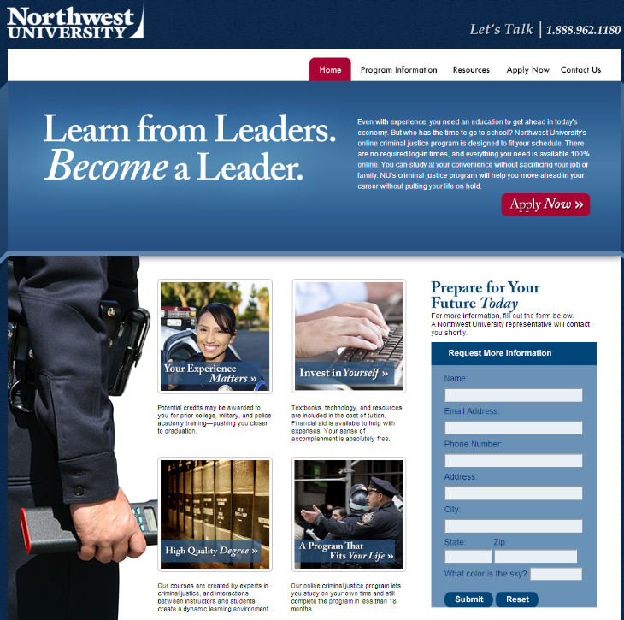
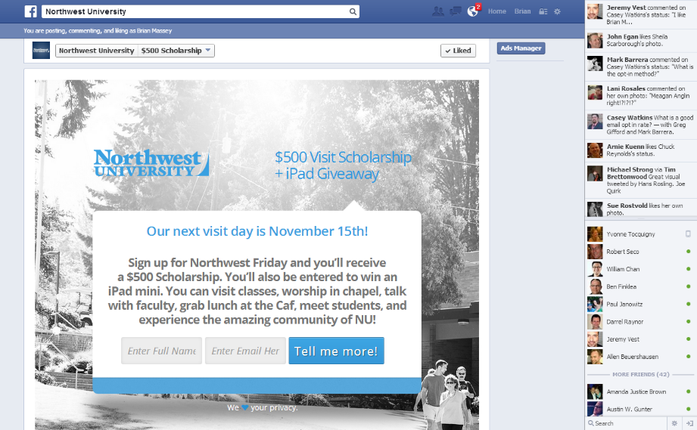
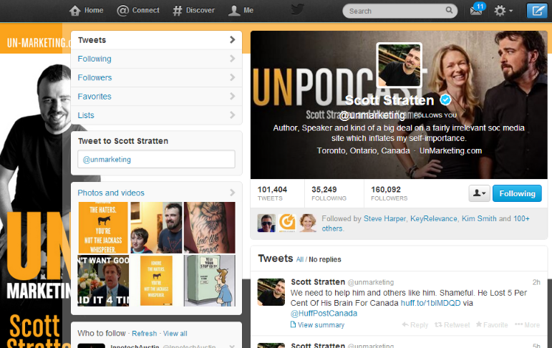
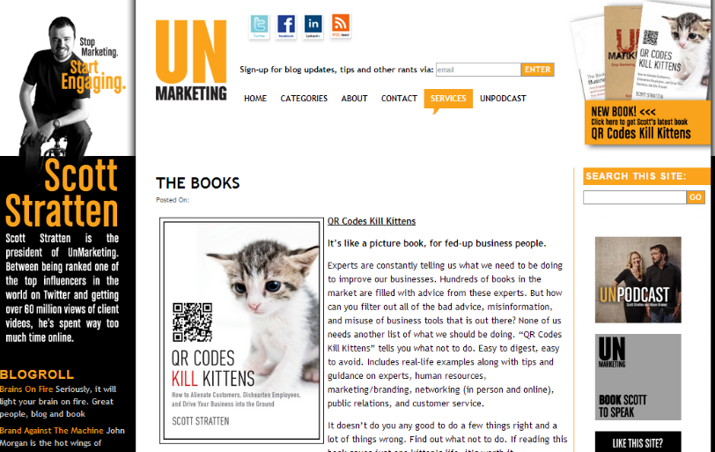
Two Places for Landing Pages
On-Network
Off-Network
Notes:
On-network:
Visitor doesn’t have to leave familiar network
Support rich media-Pictures + Video
Many distractions
Social network owns database
Off-network:
Full control of message and experience
Company owns database

Slide 28
Most Common Content Landing Page
The Blog
Notes:
Posts with links get shared more.
Links get people back to your site.

Slide 29
Where to Make Offers

Slide 30
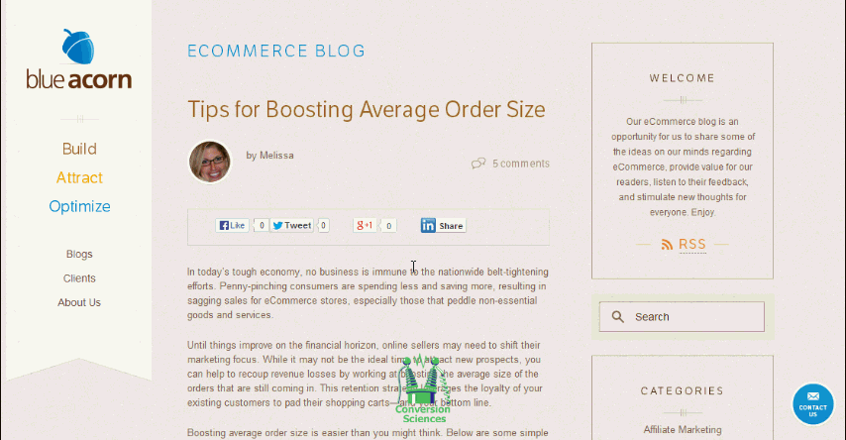
If Nothing Else,
Link Back to Your Selling Site

Slide 31
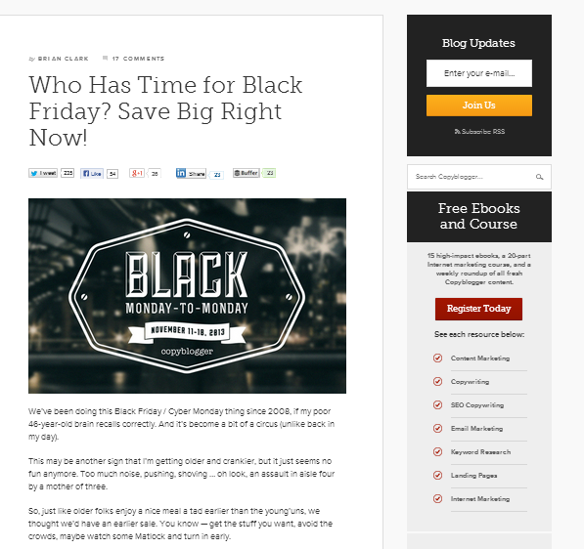
Top of Sidebar
Notes:
Advantage: If you have an autoresponder

Slide 32
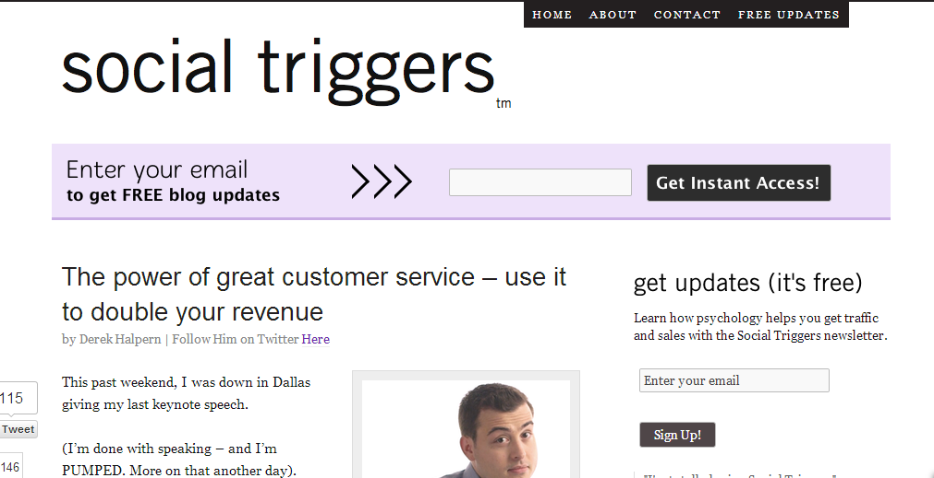
Before Content

Slide 33
In Content

Slide 34
After Content
Notes:
Advantage: If you have an autoresponder

Slide 35
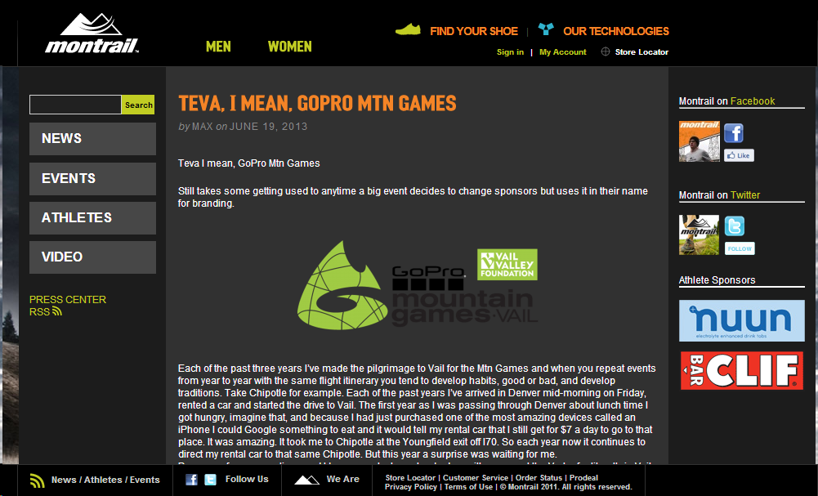
Start the Sales Process

Slide 36
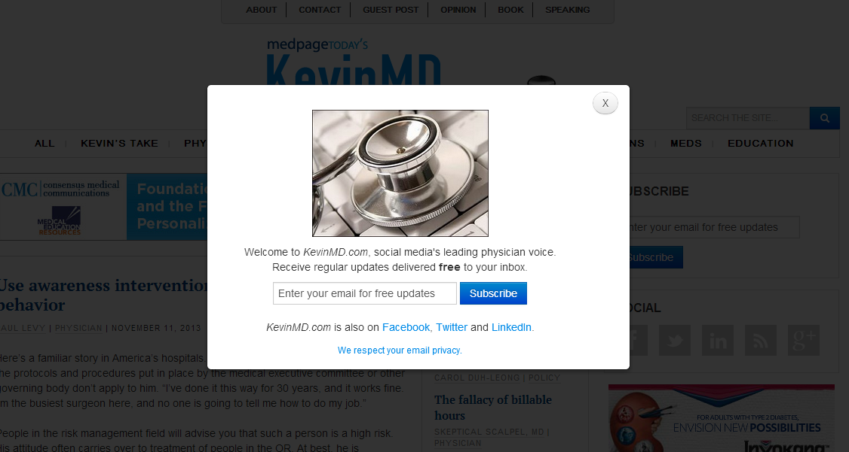
Arrival Overlay
Notes:
Advantage: If you have an autoresponder

Slide 37
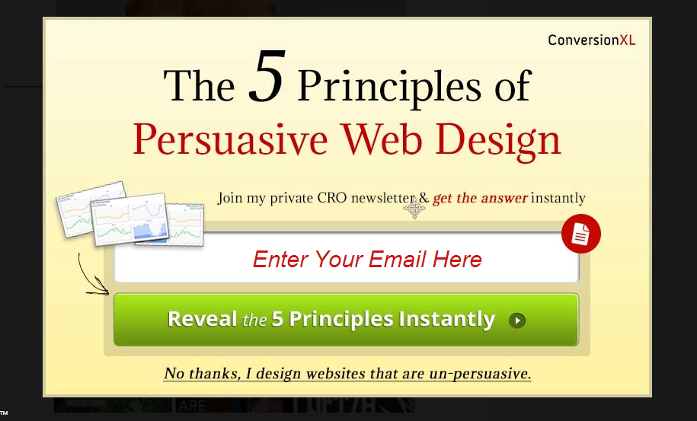
Arrival Overlay
Notes:
Advantage: If you have an autoresponder

Slide 38
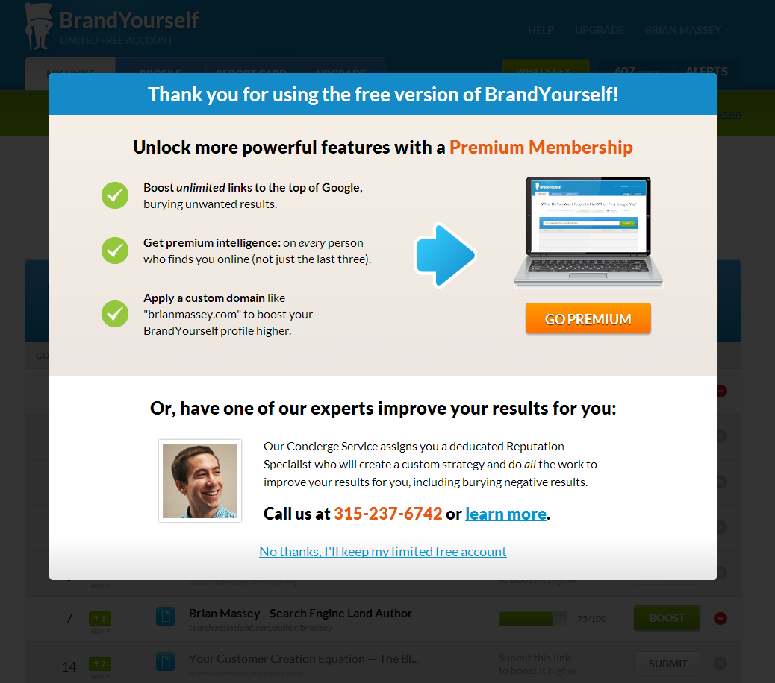


Slide 39
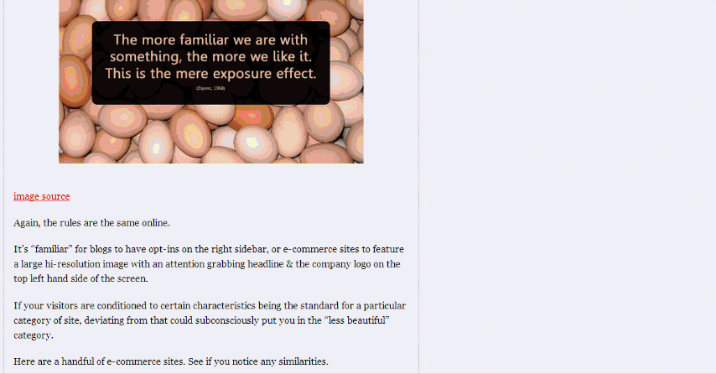
Scroll-triggered Overlay
Notes:
Advantage: If you have an autoresponder

Slide 40
Sticky Overlays

Slide 41
In Your Mobile Template
Notes:
Advantage: If you have an autoresponder

Slide 42



Ditch the Form

Slide 43
What works best?
“Add to Cart” for ecommerce
Arrival popovers for subscribers
In-content and above-content offers for blog posts

Slide 44
Build Some Trust
Tr
Trust
If your company or brand is known to the visitors, make it prominent to build trust.

Slide 45
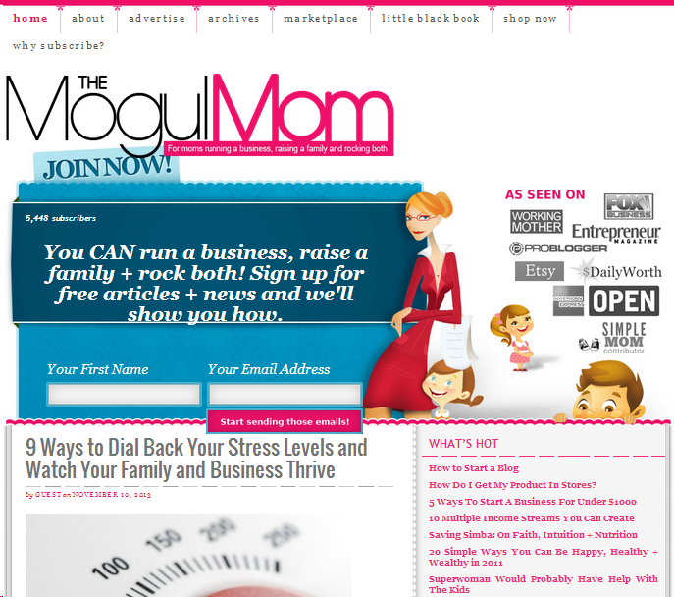
Borrowed Trust and Social Proof
Social Proof and
Trust Building

Slide 46
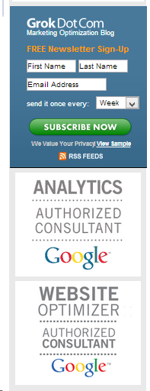
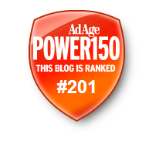


Proof of Credibility

Slide 47




Purchase with Trust

Slide 48
Provide Proof
Pr
Proof

Slide 49
Content Provides Proof

Slide 50
Images Engage Different Social Networks
I
Image

Slide 51
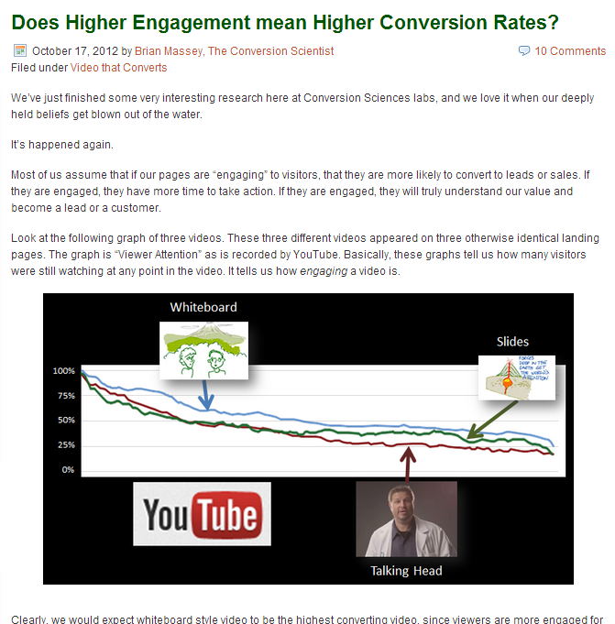
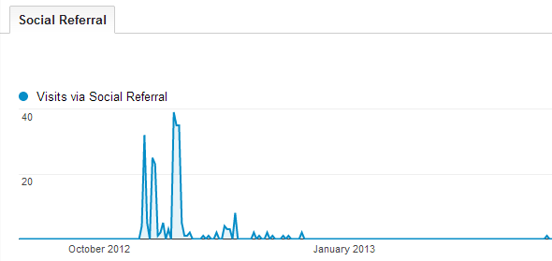
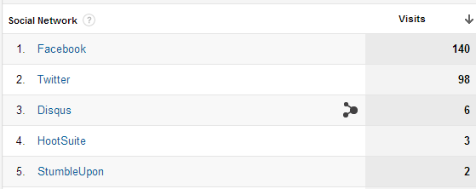
Facebook Likes Images

Slide 52
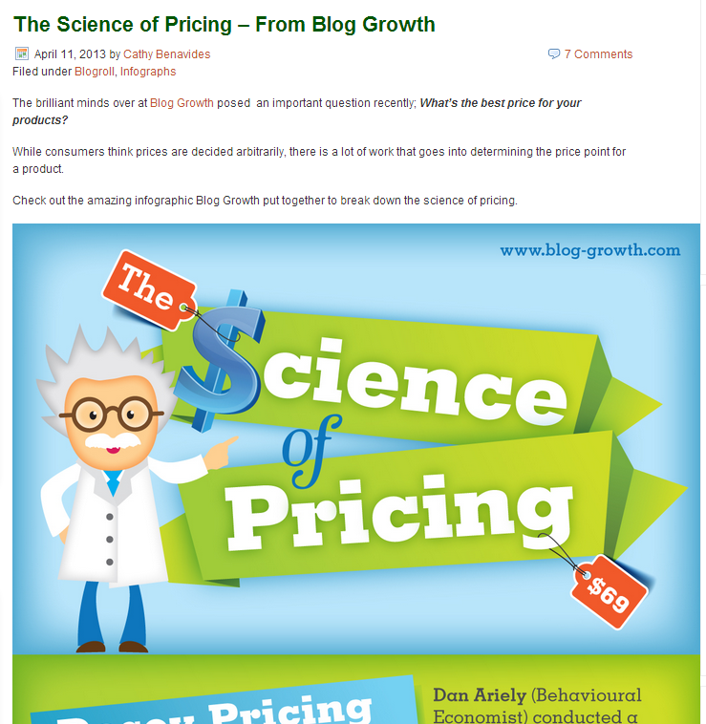
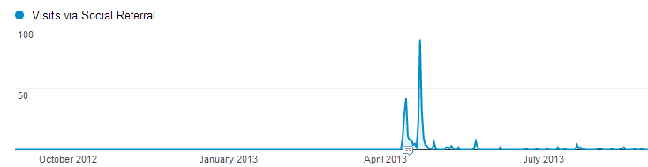
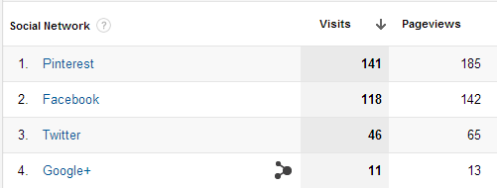
Pinterest Likes Infographs

Slide 53
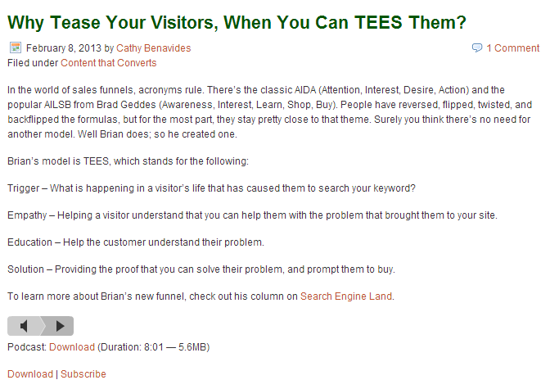
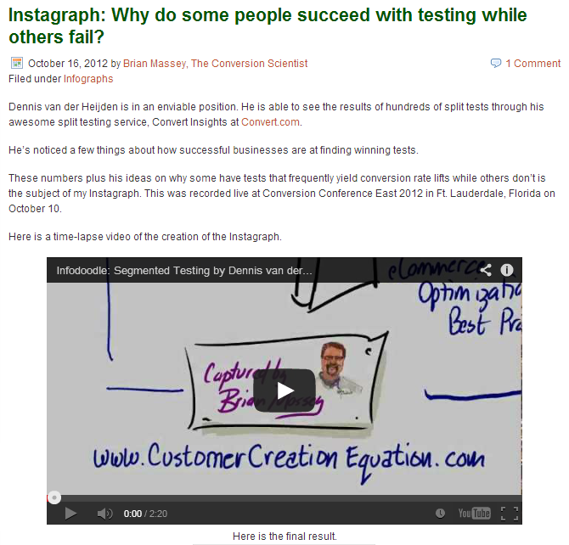

Twitter Likes Audio and Video

Slide 54
Avoid Abandonment
Ab
Abandon

Slide 55


Slide 56


Slide 58
How is my network growing?

Slide 59

Network Growth Looks Healthy

Slide 60

Network Growth Looks Healthy

Slide 61




Content Drives Engagement

Slide 62
How many people are visiting my
Landing Pages from social site?

Slide 63



Slide 64
Which Content is Most Interesting to
Social Visitors?

Slide 65

Social Visits by Landing Page

Slide 66
How many of my social visitors are buying?

Slide 67


Slide 68
Where am I losing social visitors?

Slide 69

Home Page Keeps Pinterest Interested
Product Pages are Poor Entry Points
eCommerce Site

Slide 70

Product Pages are Poor Entry Points for Facebook, too
eCommerce Site

Slide 71


Homing Beacons
URL Shorteners

Slide 72



Mission Control
Social Media
Management
Analytics

Slide 73
SO… What would you do if you got a chance to be published on Social Media Examiner?

Slide 74
1. Come up with an Offer that appeals to these visitors (who aren’t looking for books necessarily)
Of
Download a free chapter of my book.
Offer
Fm
Simply provide your name and email address.
Form

Slide 75
2. Create a Landing Page that Keeps the promise and gets them to take action.
Image
Trust
Trust
Proof

Slide 76
3. Create a link using a URL Shortener so I can track the clicks.
http://conversci.com/freechapter

Slide 77


Capítulo Gratis en Español
En este capítulo aprenderás cómo poner en marcha tu
propia fórmula para atraer más clientes a tu negocio a
través del poder de las Landing Pages ¡Y más!
http://conversci.com/engagechapter

